Slide 1
Lecture 8-9 Inheritance

Slide 2
Inheritance
C++ strongly supports the concept of reusability.
Once a class has been written and tested, it can be adopted by another programmers. This is basically created by defining the new classes, reusing the properties of existing ones.
The mechanism of deriving a new class from an old one is called 'INHERITANCE’.
The old class is called 'BASE' (parent )class and the new one is called 'DERIVED’ (child )class.

Slide 3
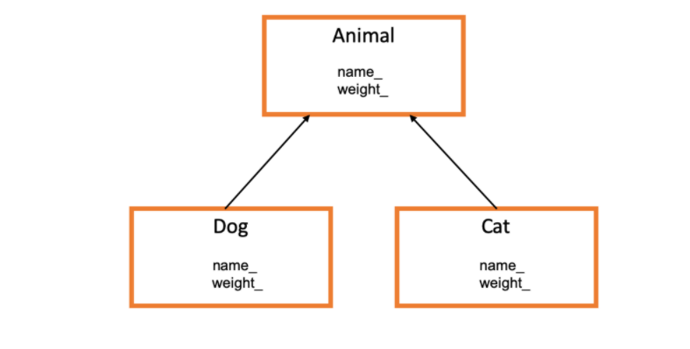

Slide 4
In the inheritance, some of the base class data elements and member functions are inherited into the derived class.
We can add our own data and member functions and thus extend the functionality of the base class.
Inheritance, when used to modify and extend the capabilities of the existing classes, becomes a very powerful tool for incremental program development.

Slide 5
When a class inherits from another class, there are three benefits:
(1) You can reuse the methods and data of the existing class
(2) You can extend the existing class by adding new data and new methods
(3) You can modify the existing class by overloading its methods with your own implementations

Slide 6
In C++, we have 5 different types of Inheritance.
Single Inheritance
Multiple Inheritance
Hierarchical Inheritance
Multilevel Inheritance
Hybrid Inheritance (also known as Virtual Inheritance)

Slide 7
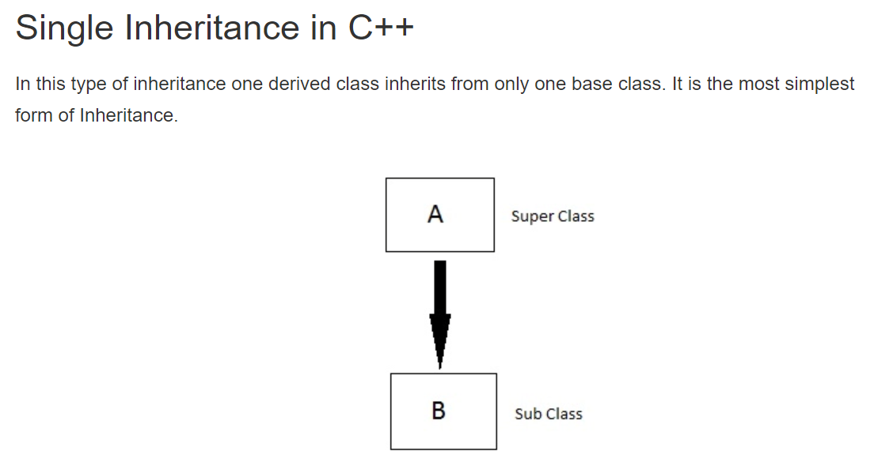
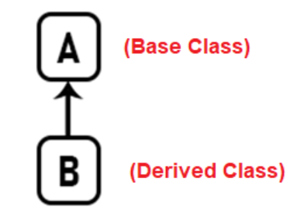

Slide 8
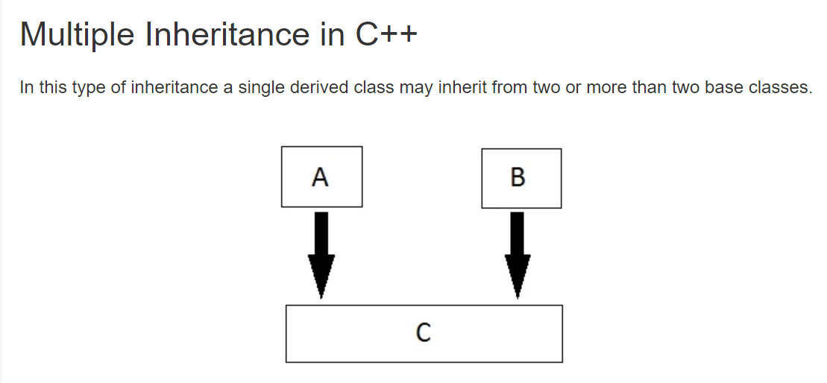
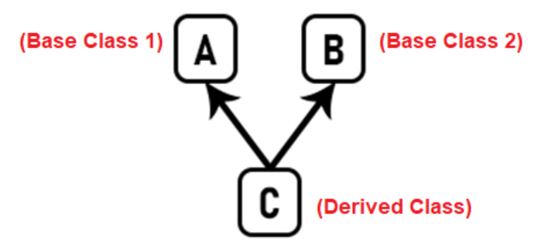

Slide 9
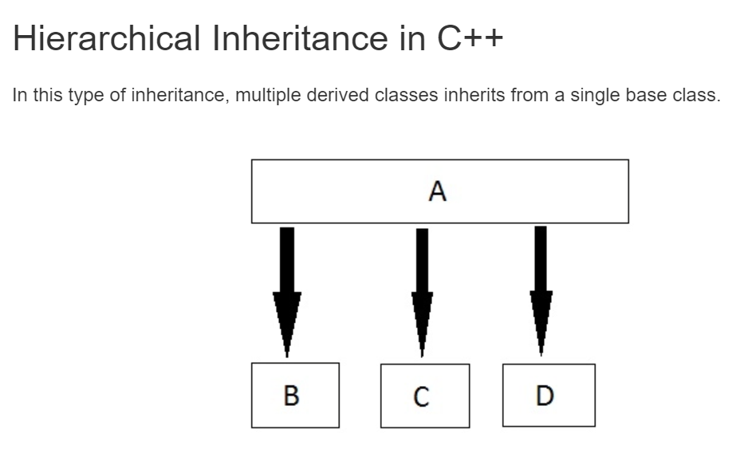
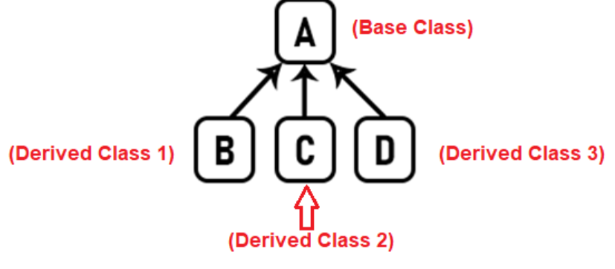

Slide 10
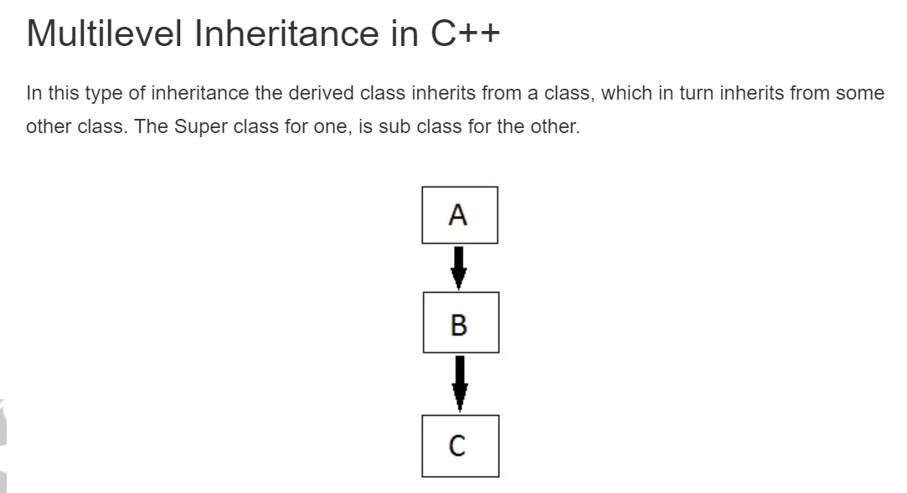
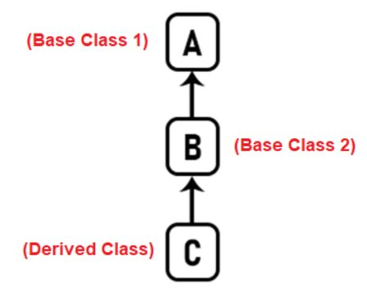

Slide 11
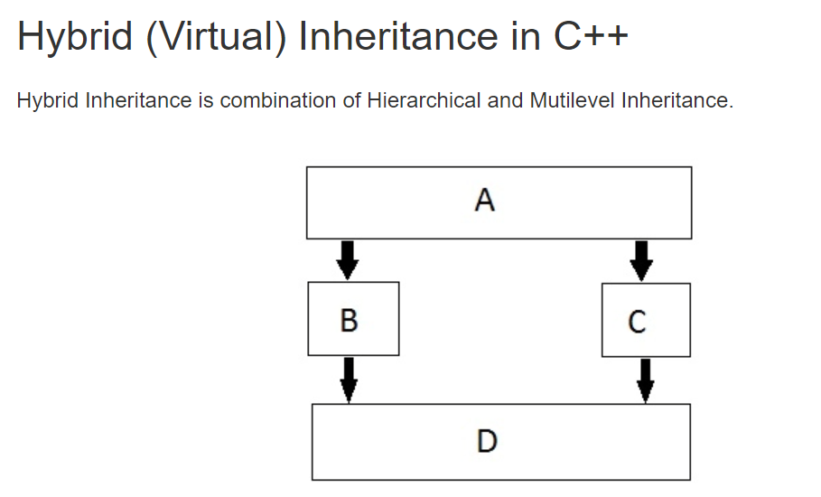
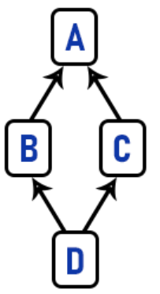

Slide 12
Defining Derived Classes
A derived class is specified by defining its relationship with the base class in addition to its own details.
The general syntax of defining a derived class is as follows:
class derived_classname : Access specifier baseclass name
{ __
__ // members of derived class
};
The access specifier or the visibility mode is optional
By default it is private.

Slide 13
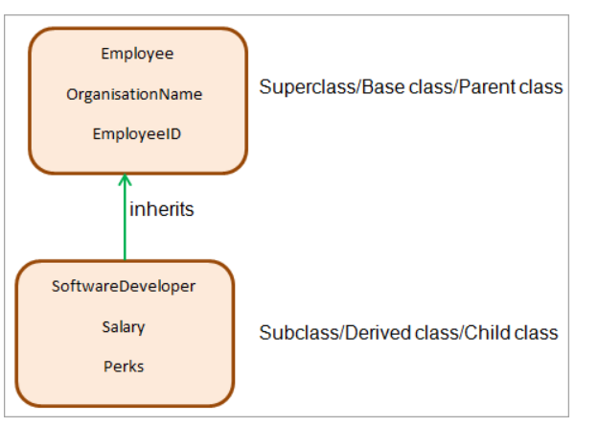
Example

Slide 14
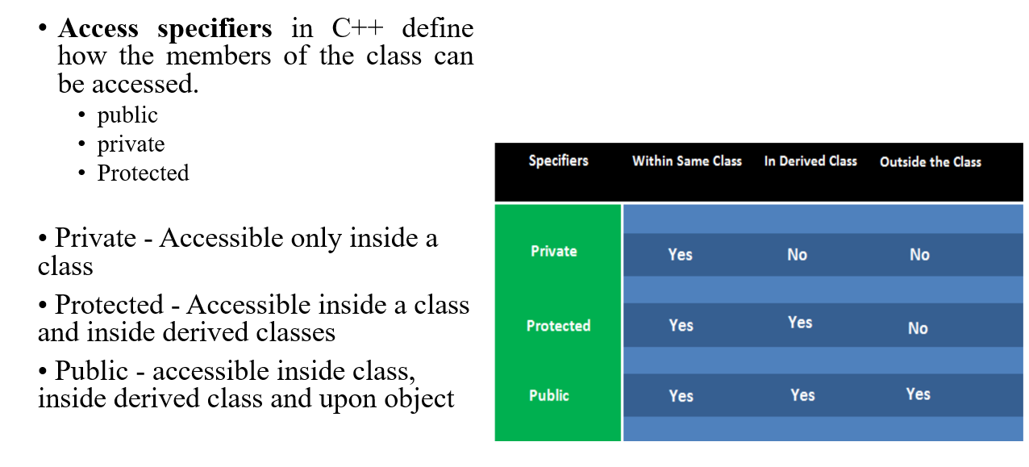

Slide 15
class employee //base class
{
members of employee
};
class SoftwareDeveloper : public employee //public derivation
{
Extra members of software developer
};
class Testers: employee //private derivation (by default)
{
Extra members of Testers
};

Slide 16
#include <iostream> //Within the derived class
using namespace std;
class A
{
int a;
public: int b;
protected: int c;
public: A(){ a=1;b=2;c=3;}
public:
void fun()
{
cout<<"from function "<<a<<endl;
}};
class B:public A
{
public:
void dfun()
{
//cout<<a; //cant access
cout<<b;
cout<<c;
}};
int main()
{
B b1;
b1.dfun();}

Slide 17
class Animal
{
char color[10]; //can’t inherit
public:
int legs = 4;
char type[10]; // omnivorous // carnivorous etc..
};
// Dog class inheriting Animal class
class Dog : public Animal
{
public:
int tail = 1;
Dog() { .....}
};
int main()​
{​
Dog d;​
cout << d.legs;​
cout<<d.type;​
cout << d.tail;​
}

Slide 18
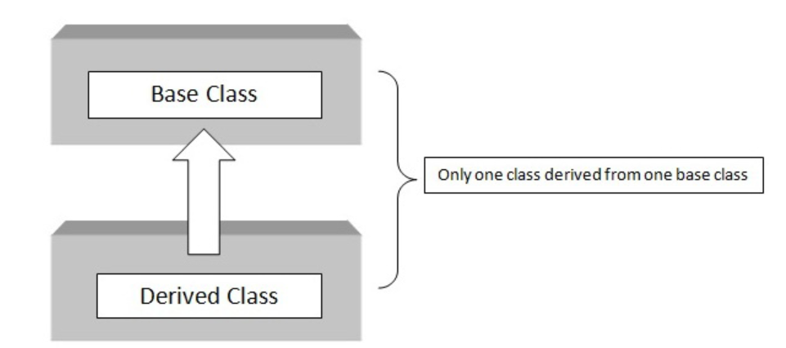

Slide 19
class A // base class
{
..........
};
class B : access_specifier A // derived class
{
...........
} ;

Slide 20
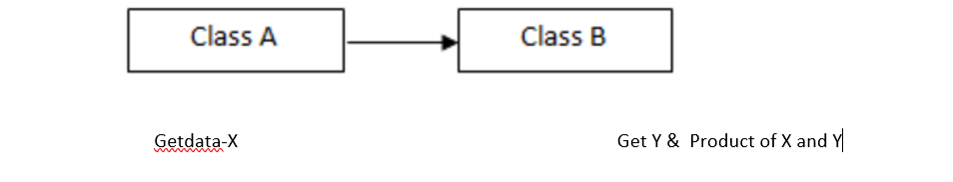

Slide 21
// inheritance.cpp
#include <iostream>
using namespace std;
class base //single base class
{
public:
int x;
void getdata()
{
cout << "Enter the value of x = "; cin >> x;
}
};
class derive : public base //single derived class
{
private:
int y;
public:
void readdata()
{
cout << "Enter the value of y = "; cin >> y;
}
void product()
{
cout << "Product = " << x * y;
}
};
int main()
{
derive a; //object of derived class
a.getdata();
a.readdata();
a.product();
return 0;
}

Slide 22
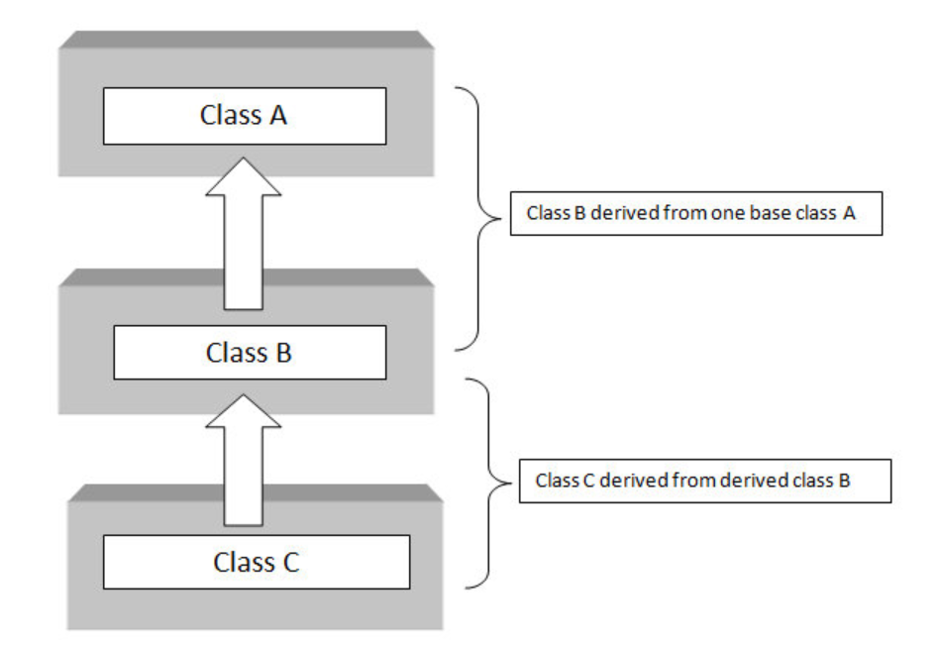
Multilevel inheritance

Slide 23
class A // base class
{
...........
};
class B : acess_specifier A // derived class
{
...........
} ;
class C : access_specifier B // derived from derived class B
{
...........
} ;

Slide 24
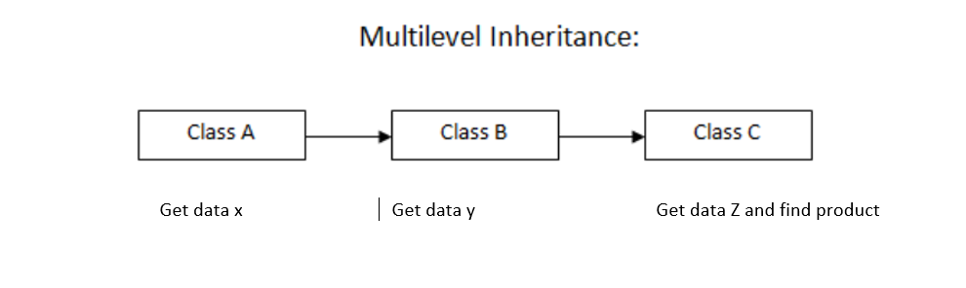

Slide 25
class derive2 : public derive1 // derived from class derive1
{
private:
int z;
public:
void indata()
{ cout << "\nEnter value of z= "; cin >> z;
}
void product()
{ cout << "\nProduct= " << x * y * z;
}
};
int main()
{
derive2 a; //object of derived class
a.getdata();
a.readdata();
a.indata();
a.product();
return 0;
} //end of program
class base //single base class
{ public:
int x;
void getdata()
{
cout << "Enter value of x= "; cin >> x;
}
};
class derive1 : public base
{ public:
int y;
void readdata()
{
cout << "\nEnter value of y= "; cin >> y;
}
};

Slide 26
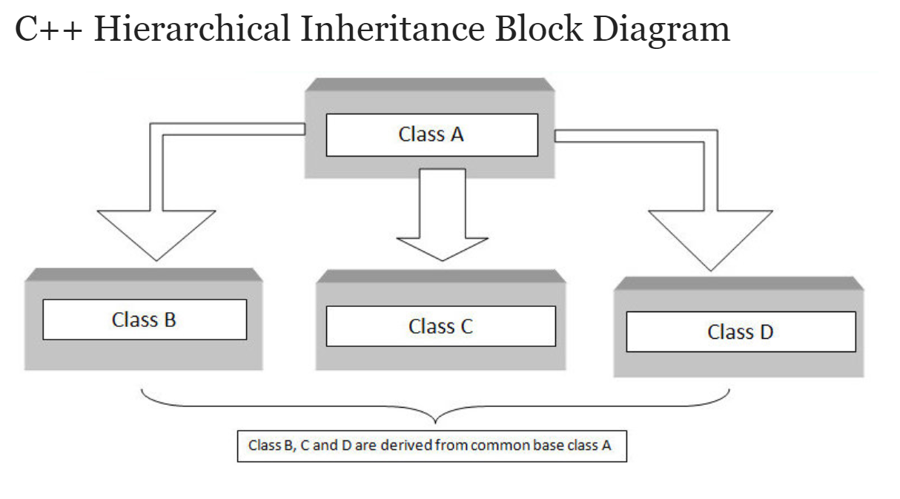

Slide 27
class A // base class
{
..............
};
class B : access_specifier A // derived class from A
{
...........
} ;
class C : access_specifier A // derived class from A
{
...........
} ;
class D : access_specifier A // derived class from A
{
...........
} ;

Slide 28
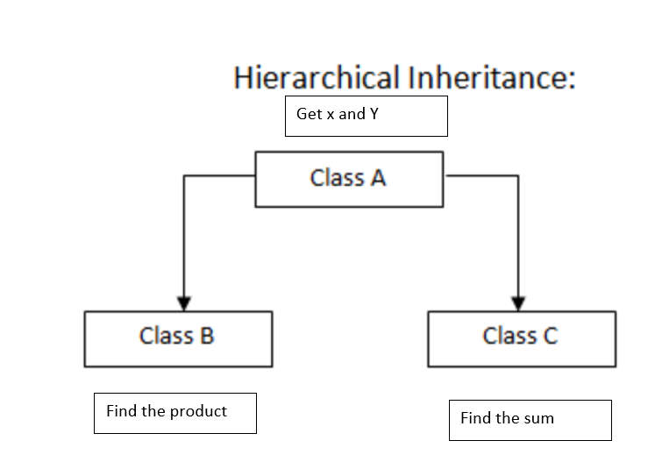

Slide 29
// hierarchical inheritance
#include <iostream>
using namespace std;
class A //single base class
{
public:
int x, y;
void getdata()
{
cout << "\nEnter value of x and y:\n"; cin >> x >> y;
}};
class B : public A //B is derived from class base
{ public:
void product()
{ cout << "\nProduct= " << x * y;
}
};
class C : public A //C is also derived from class base
{ public:
void sum()
{
cout << "\nSum= " << x + y;
}
};
int main()
{ B obj1; //object of derived class B
C obj2; //object of derived class C
obj1.getdata();
obj1.product();
obj2.getdata();
obj2.sum();
return 0;
} //end of program

Slide 31
class A
{
..........
};
class B
{
...........
} ;
class C : access_specifier A,access_specifier B // derived class from A and B
{
...........
} ;

Slide 32
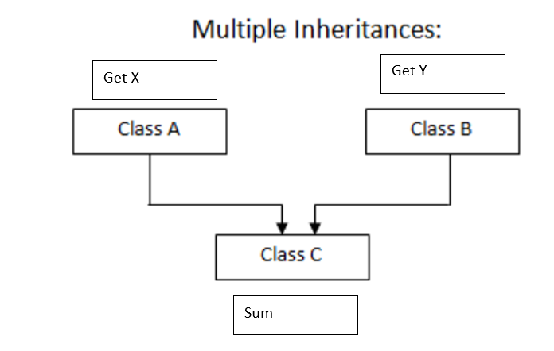

Slide 33
// multiple inheritance.cpp
class A
{ public:
int x;
void getx()
{
cout << "enter value of x: "; cin >> x;
}
};
class B
{ public:
int y;
void gety()
{
cout << "enter value of y: "; cin >> y;
}
};
class C : public A, public B //C is derived from class A and class B
{
public:
void sum()
{
cout << "Sum = " << x + y;
}
};
int main()
{
C obj1; //object of derived class C
obj1.getx();
obj1.gety();
obj1.sum();
return 0;
} //end of program

Slide 34
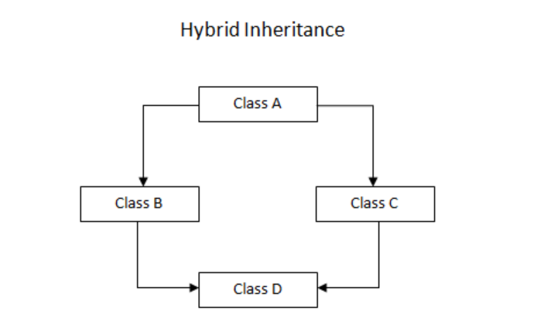
Class B and class C are inherited from class A.
Class D is inherited from two class B and class C.
Indirectly class D is inherited from class A, twice, through class B and class C.
Hence, class D will have two sets of copies of data members of class A. One through class B and the other through class C.

Slide 35
class A
{
Body of class A
};
class B : virtual public A
{
Body of class B
};
class C : virtual public A
{
Body of class C
};
class D : public B, public C
{
Body of class C
};
When class is made virtual base class then special care is taken by c++ to make sure that only one copy of that class is inherited regardless of how many inheritance paths exists between the virtual base class and derived class.

Slide 36
Get X
Get Y
Get Z
Find product X*Y*Z

Slide 37
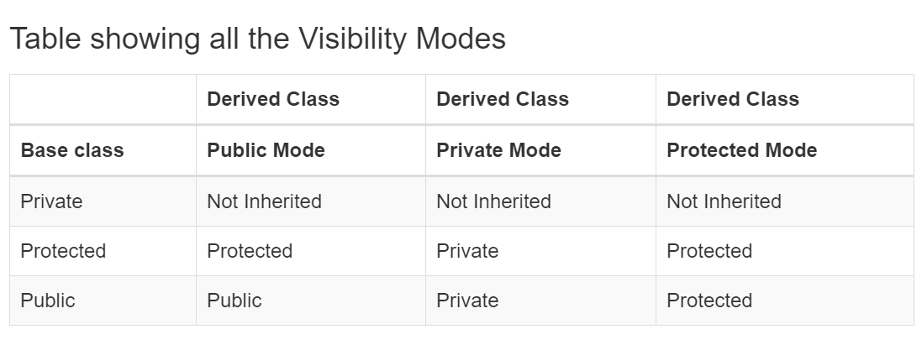
Access Control and Inheritance
public inheritance makes public members of the base class public in the derived class, and the protected members of the base class remain protected in the derived class.
protected inheritance makes the public and protected members of the base class protected in the derived class.
private inheritance makes the public and protected members of the base class private in the derived class.

Slide 38
class Base {
public:
int x;
protected:
int y;
private:
int z;
};
class PublicDerived: public Base {
// x is public
// y is protected
// z is not accessible from PublicDerived
};
class ProtectedDerived: protected Base {
// x is protected
// y is protected
// z is not accessible from ProtectedDerived
};
class PrivateDerived: private Base {
// x is private
// y is private
// z is not accessible from PrivateDerived
}

Slide 39
How to access private member of base class from derived class?

Slide 40
class PublicDerived : public Base {
public:
// function to access protected member from Base
int getProt() {
return prot;
}
};
int main() {
PublicDerived object1;
cout << "Private = " << object1.getPVT() << endl;
cout << "Protected = " << object1.getProt() << endl;
cout << "Public = " << object1.pub << endl;
return 0;
}
// C++ program to demonstrate the working of public inheritance
#include <iostream>
using namespace std;
class Base {
int pvt ;
protected:
int prot ;
public:
int pub;
Base(){pvt=prot=pub=1;}
// function to access private member
int getPVT() {
return pvt;
}
};

Slide 41
IS-A realtionship Vs HAS-A relationship
One of the advantages of an Object-Oriented programming language is code reuse.
There are two ways we can do code reuse either by the implementation of inheritance (IS-A relationship), or object composition (HAS-A relationship).
U can get the functionality of inheritance when you use composition also.

Slide 42
IS- A relationship
the concept of IS-A is a totally based on Inheritance.
It is just like saying "A is a B type of thing".
For example, Apple is a Fruit, Car is a Vehicle etc.
Inheritance is uni-directional.
For example, House is a Building. But Building is not a House.

Slide 43
HAS-A Relationship:
Composition(HAS-A) simply mean the use of instance variables that are references to other objects. For example Maruti has Engine, or House has Bathroom.

Slide 44
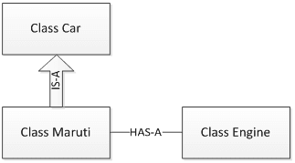
IS-A and HAS-A

Slide 45
#include <iostream>
using namespace std;
class car
{
private:
string color;
int maxspeed;
public:
void read()
{
cin>>color>>maxspeed;
}
void carInfo(){
cout<<color<<maxspeed;
}
};
class Engine {
public:
void start(){
cout<<"Engine Started:";
}
void stop(){
cout<<"Engine Stopped:";
}
};
class Maruti:public car{
public:
void MarutiStartDemo(){
Engine MarutiEngine;
MarutiEngine.start();
}
};
int main()
{
Maruti M;
M.read();
M.carInfo();
M.MarutiStartDemo();
return 0;
}

Slide 46
